Slide 1
STOCK FORECASTING USING HIDDEN MARKOV MODELS
Team Members
Aman Verma
Kushank Maheshwari
Snehil Gupta
Sparsh Agarwal
Birla Institute of Science & Technology
Pilani Campus

Slide 2

Problem Statement
Stock Markets are one the most complex systems which are almost impossible to model in terms of dynamical equations.
Classical problem of non-stationary pattern recognition in Machine Learning.

Slide 3
HMM Overview
Proposed Solution
Hidden Markov Models
Stocks as Hidden Markov Models
How to use Hidden Markov Models?
Prediction of Stock Prices
How to select the best model?
Non-probabilistic model- LSTM
Results
Conclusion
Use probabilistic model – Hidden Markov Models
Train the model using the historical data
Form a generative model
Optimize model and model parameters
Predict next day’s prices- Open Price, Closing Price, High and Low
Use non-probabilistic model – LSTM
Compare the results with the results obtained using HMM

Slide 4
Hidden Markov Models
Strong probabilistic framework (Generative Model) for recognizing patterns in Stochastic Processes.
Idea behind HMM- The likelihood of the observations depend on the states which are ‘hidden’ to the observer.
The states keep changing as Markov Process with certain transition probability.
The observations can be discrete or continuous but the states are always discrete.
The probability of observations given a state are determined by the emission probability.
Emission probabilities can be PDF or PMF.
Hidden States
S1
S2
S3
y1
y2
y3
Observations

Slide 5
Stocks as Hidden Markov Models
There are underlying ‘hidden’ states which drive the stock prices.
Investor can observe only the stock prices.
States and the transition probabilities are unknown.
Observations are continuous vector- Open Price, Closing Price, High and Low.
Emission probabilities are PDF and assumed to be multivariate Gaussian distribution since observations are continuous in nature.

Slide 6







Stocks as Hidden Markov Models

Slide 7
How to use Hidden Markov Models?
This is answered by answering following three questions.
Given the model, how likely it is to observe the given sequence of data?
Given the model and observations, what is the best hidden state sequence?
Given the observations, what are the optimal model parameters?
The first problem can be solved by Forward algorithm.
The second problem can be solved by Viterbi algorithm.
The third problem can be solved by Baum-Welch algorithm.
In Our Project we only require to solve the first two questions.

Slide 8




Prediction of Stock Prices
Consider a window W_{t} of k previous observations from today and calculate its log-likelihood given the model.
Compare it with the log-likelihood of the previous sub-sequences of the same size by shifting the window by one day in the direction of past data.
Identify a sub-sequence W_{t-j} whose log-likelihood is the closest to that of the sub-sequence W_{t}.
j = argmin_{i} |P(O_{t}, O_{t—1}, O_{t—2} …, O_{t—k} / ƛ) — P(O_{t-i}, O_{t—i-1},O_{t-i-2} …, O_{t-i-k} / ƛ)I where i = 1,2, ....(t/k)
W_{t}
W_{t-1}
Calculate the differential price change between the latest day of the window W_{t-j} and its next day’s price and add it to the current day’s price to get our next day's prediction.
O_{t+1} = O_{t} + (O_{t-j+1} - O_{t-j})
As the true observations are received. they are included in the data
set and model is trained again for further predictions.

Slide 9

Implementation using 4 state model

Slide 10

How to select the best model?

Slide 11
NOTE:
Our research paper for the HMM is highly inspired by the research paper of Nguyet Nguyen[1] which took an assumption that stock market follows 1st order markov chain. However, to confirm this assumption, we basically formulated Hypothesis Testing on the data to check if the stock prices follow 1st order markov chain. We further visualized the Transition matrix and tried to understand the Hidden states that drive the prices.
[1]Nguyet Nguyen, Stock Price Prediction using Hidden Markov Model, Youngstown State University, Ohio, USA

Slide 12
Formulation of Models for Transition Matrix
Observable Parameters: Closing, Opening, High and Low Price of a stock for a particular day. Using these values, we will try to model the stocks prices for a particular day and try to infer its movement.
Further, the states we have assumed for formulating the transition matrix are Up, Down and Stagnant Movement of prices of a stock price on a day change with respect to previous day. For categorising these movements, we have then considered the following parameters:
Model
Difference Pattern
Difference Range
Closing Prices for nth & (n-1)th day
Closing & Opening Prices for nth day
Static Range
Dynamic Range

Slide 13
Difference Range
Static Range: A fixed value to classify the difference values. This fixed value is fixed for each day of our data and was taken as 1.5 times the mean of difference value.
Down: [Minimum Value of Difference, - Fixed Value]
Stagnant: [- Fixed Value, Fixed Value]
Up: [Fixed Value, Maximum Value of Difference]
Dynamic Range: |Change| ∗ (Open Price)/2 where Change = (Difference Value)/(Open Price)
Down: [Minimum Value of Difference, -Dynamic Value]
Stagnant: [- Dynamic Value, Dynamic Value]
Up: [Dynamic Value, Maximum Value of Difference]

Slide 14
Models formulated
Model 1:
Difference Pattern: Close Price for nth day - Close Price for(n − 1)th day Difference Range: Static Method.
Model 2:
Difference Pattern: Close Price for nth day - Open Price for n th day Difference Range: Static Method.
Model 3:
Difference Pattern: Close Price for nth day - Close Price for (n − 1)th day Difference Range: Dynamic Method
Model 4:
Difference Pattern: Close Price for nth day - Open Price for n th day Difference Range: Dynamic Method

Slide 15
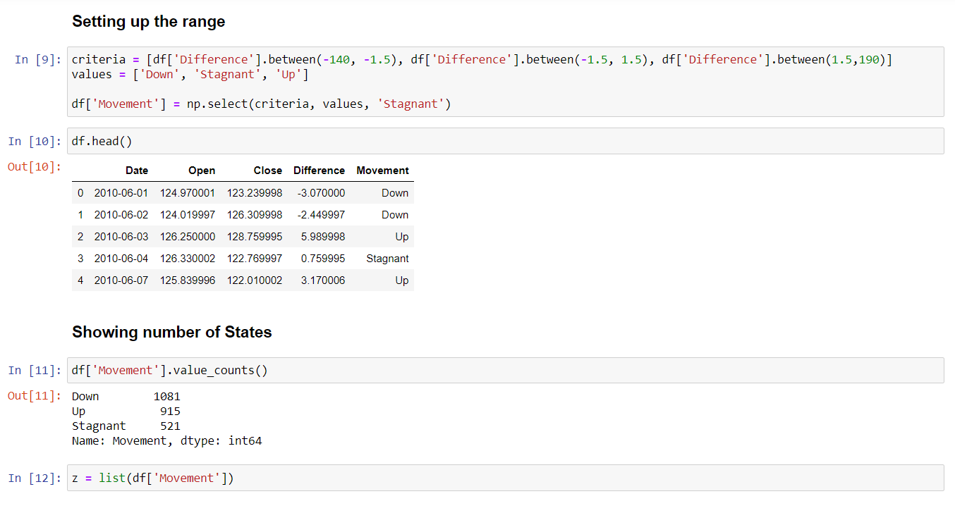
Sample Code for Model 1

Slide 16
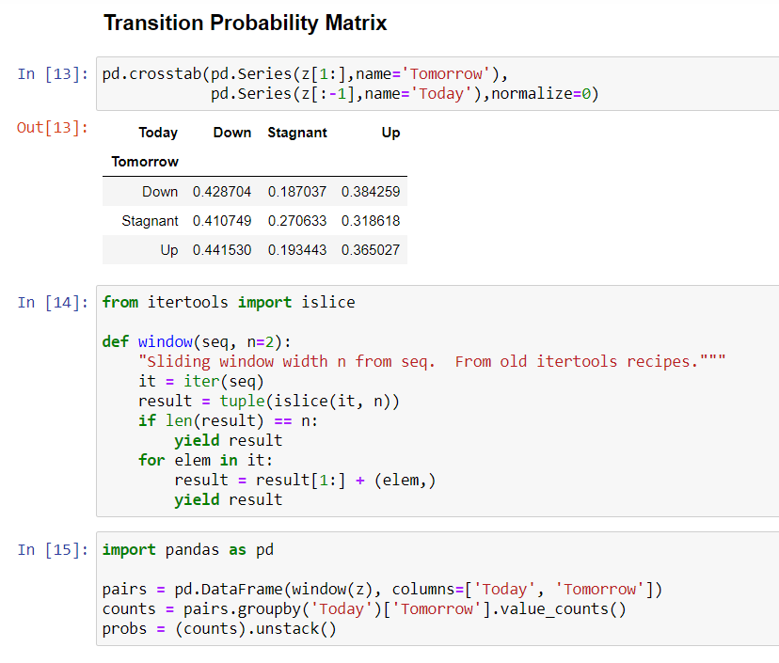
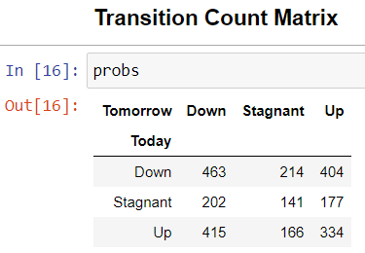
Transition Matrix for Model 1

Slide 17
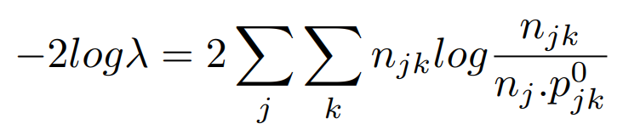
Hypothesis Testing for 1st order Markov Chain
Assumption:
We consider the transition matrix for the 4 models follow the 1st order markov chain (i.e dependent on the previous state) for different time frames of 6 months and 10 years.
Procedure:
We use the null hypothesis criteria we obtain the chi-squared probability for the different models at different times frames. High probability implies that the model follows the 1st order markov chain

Slide 18
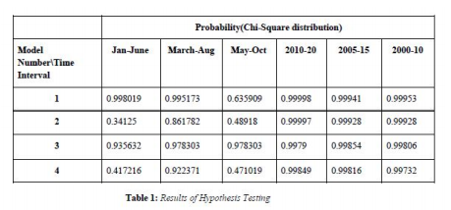
Results
6 Month Timeframe: We observe that some models are following the stated null hypothesis while the hypothesis is being rejected for others. Hence, the high variability of probability give us the fact that in general the stock market do not follow a Markovian Chain for shorter time-intervals.
10 Year Timeframe: We observe the probabilities, irrespective of models yield a result of around 99% stating they follow of 1st order Markov Chain.
Model 3: All probabilities across both shorter and longer duration of time are above 90%, stating that the Successive day difference of closing price for Difference pattern and dynamic behaviour of Difference range gives the best results. Also it provides a justification for considering the Up, Down and Stagnate State spaces as a possibility for Hidden States of a Stock Model modelled with HMM proving that there are indeed hidden states that drive the Stock prices in a Stock market.

Slide 19
Summary
We implemented HMM model similar to that of Nguyet Nguyen and visualized the Hidden States of the Stock market modelled through HMM using Transition probability matrix estimation.
We took some basic assumptions before applying the HMM model that there exists hidden states driving stock prices, which we verified later during hypothesis testing.
The testing also helped us to observe that stock market data with much longer duration is more likely to follow markovian properties than the short duration one. Therefore, we choosing the longer duration for HMM training.
It is impossible to get a model that can 100% predict the price without any error, there are too many factors that can affect the stock prices.
So, we cannot hope for a perfect model, but it is observed that the general trend of predicted price with HMM is in line with the actual data, so the trader could have an indicator for reference, and use them to make wise-decisions.
HMM is a better technique than LSTM for predicting stock prices since it has less complexity and HMM method has a better feature extraction algorithm than LSTM as it requires feature scaling which generally affects the data in general.

Slide 20
References
[1] Nguyet Nguyen, Stock Price Prediction using Hidden Markov Model, Youngstown State University, Ohio, USA

